Slide 1
Plasma Diagnostic Techniques Lecture 8
Deborah O’Connell
York Plasma Institute

Slide 2
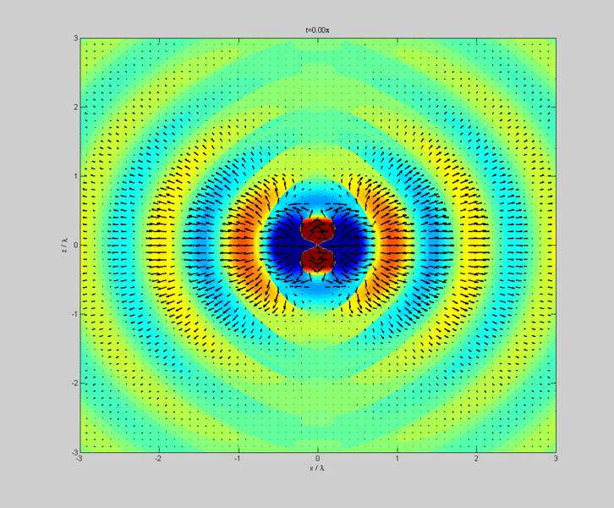
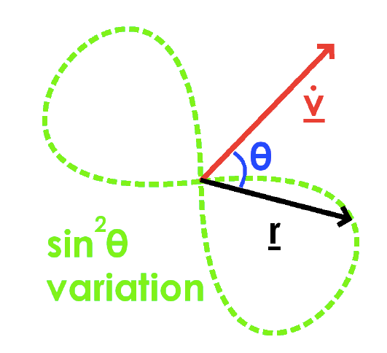
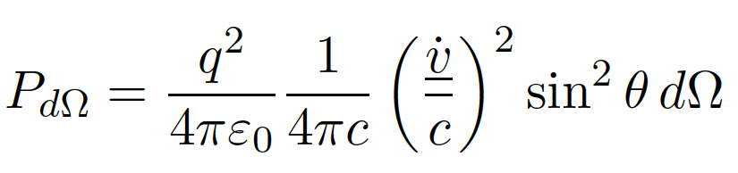
Radiation from accelerated charges
We know from undergraduate electrodynamics that accelerated charges emit radiation.
This is the basis of dipole radiation exploited in antenna technology – see animation.
Larmor’s formula provides total radiated power:
Lecture 7
Notes:
P – radiative power
Proportional to acceleration (vdot)
Angular dependence, zero radiative power for pi, maximum perpendicular to motion

Slide 3
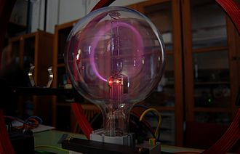
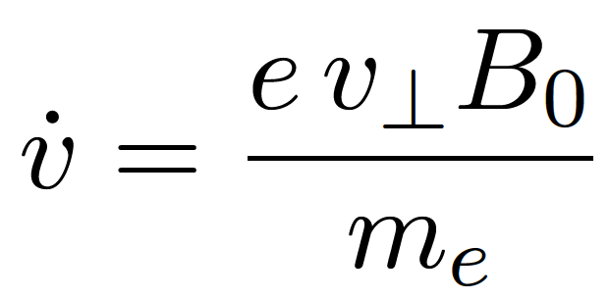
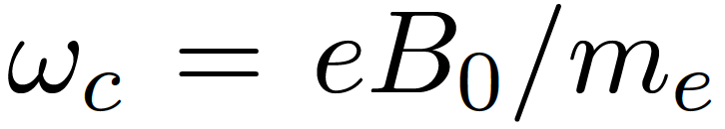
Cyclotron radiation
Electrons with a velocity component perpendicular to a magnetic field are accelerated (Lorentz force) such that:
In a homogenous magnetic field this results in a circular motion, see figure, with the cyclotron frequency:
Lecture 7

Slide 4
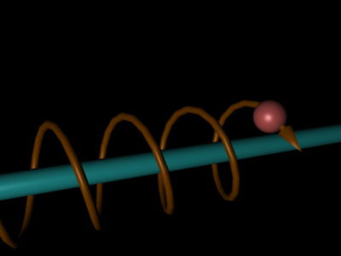
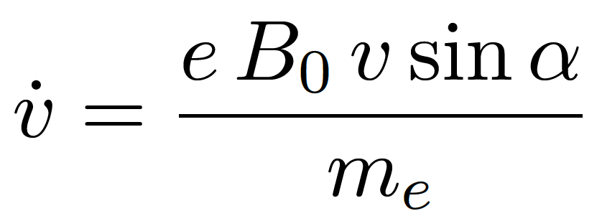
Cyclotron radiation
There is no force in the direction of the magnetic field and the parallel velocity is preserved resulting in a spiral motion – see illustration.
We can use the direction of the magnetic field as a reference frame and following the rules of the vector cross product write:
Lecture 7

Slide 5
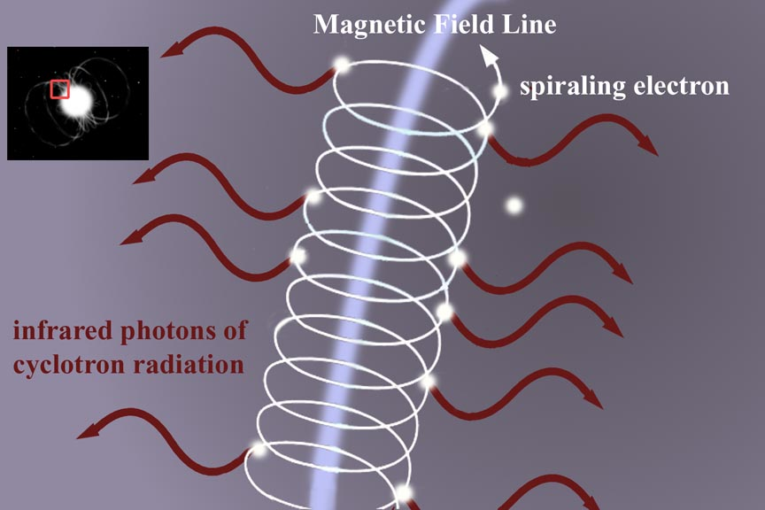
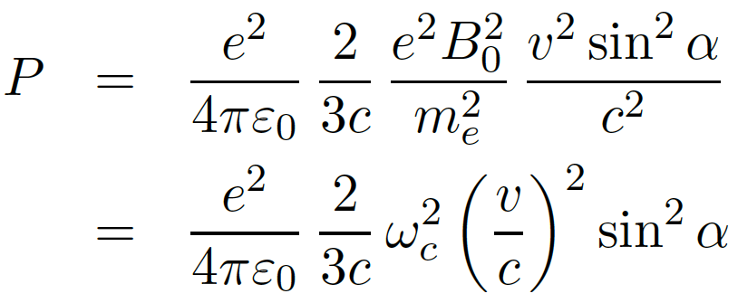
Cyclotron radiation
The cyclotron radiation power is consequently given by:
Lecture 7
Notes:
Using Larmor’s equation

Slide 6
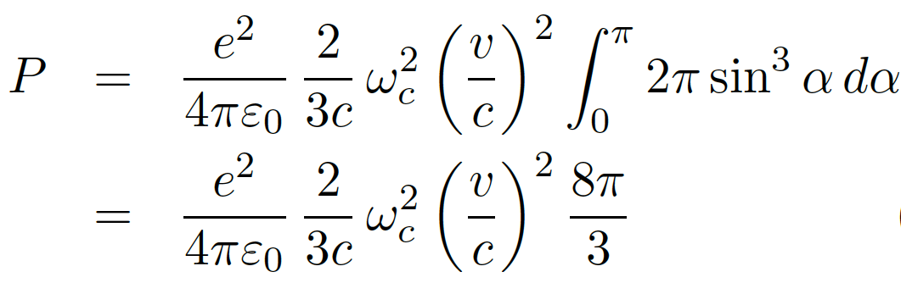
Cyclotron radiation
The cyclotron radiation power is consequently given by:
Assuming an isotropic distribution function, e.g. Maxwellian, we can integrate in space and time obtaining:
Lecture 7
Notes:
Using Larmor’s equation

Slide 7
https://www.youtube.com/watch?v=_xv_GwCgpAc
Lecture 7

Slide 8
Bremsstrahlung

Slide 9
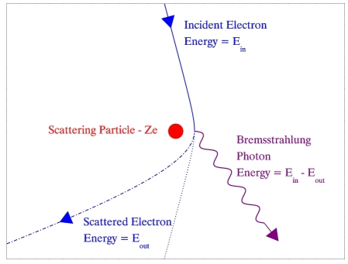
Bremsstrahlung: concept
Bremsstrahlung (German for ‘breaking radiation’) is caused by de-accelerated electrons in the vicinity of ions neglecting inelastic collision processes – see illustration.

Slide 10
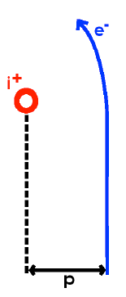
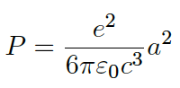
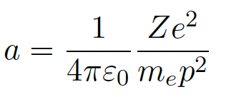
Bremsstrahlung: radiated power
The power P radiated by an electron when de-accelerated is given by:
The acceleration a of an electron in a collision with an ion at the closest point of approach p (see illustration) is given by:
Notes:
P – scatter collision parameter

Slide 11
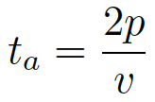
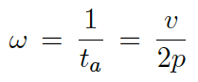
Bremsstrahlung: emitted frequency
For small angle collisions the time over which acceleration occurs can be approximated by:
The Bremsstrahlung pulse lasts for a time t_{a}, and so when Fourier analysed, produces a dominant contribution to that part of the frequency spectrum with:

Slide 12
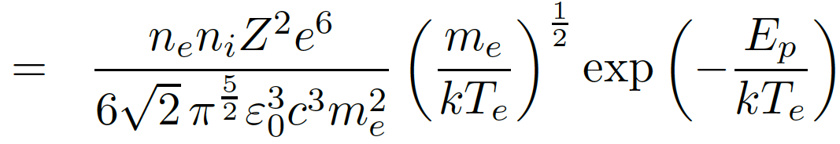
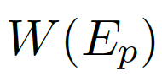
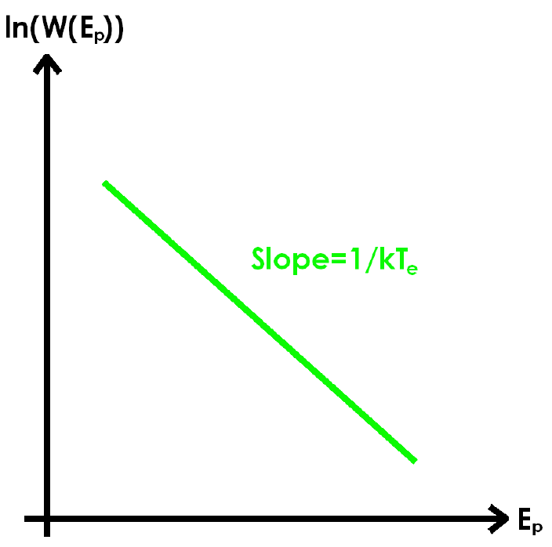
Bremsstrahlung: frequency spectrum
Assuming a Maxwellian distribution function of speeds the total energy radiated W(E_{p}) dE_{p} for a photon energy E_{p} is given by:
Details are complex and this is only a simple ‘classical’ approximation. The general scaling and dependencies, however, also hold in a full quantum mechanical treatment.
The measurement of the frequency spectrum is often employed as a diagnostics technique for the electron temperature – see figure.

Slide 13
Summary
Cyclotron radiation
Accelerated charges emit radiation
Particles undergo acceleration (changing velocity) in magnetic field and can radiate
Basis of synchrotron radiation
Bremsstrahlung
Electron acceleration (& emission) due to scattering in the presence of ions
Bremsstrahlung ‘pulses’ can be translated into a frequency space
Spectrum can be employed as a diagnostic of electron temperature

Slide 14
Recombination radiation

Slide 15
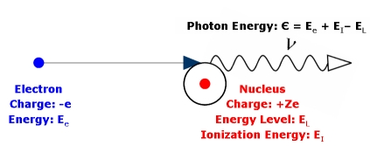
Recombination radiation: concept
In colliding with an ion, an electron can be captured by the ion and the electron end up bound in a quantum state of the ion.
All the electrons kinetic energy plus the energy difference of the final quantum state and the ionisation limit of the ion is released as photon energy.
The emission is known as recombination radiation or free-bound radiation because it results from electrons recombining from free, unbound states to bound, discrete quantum states.

Slide 16
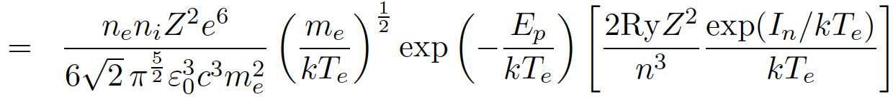
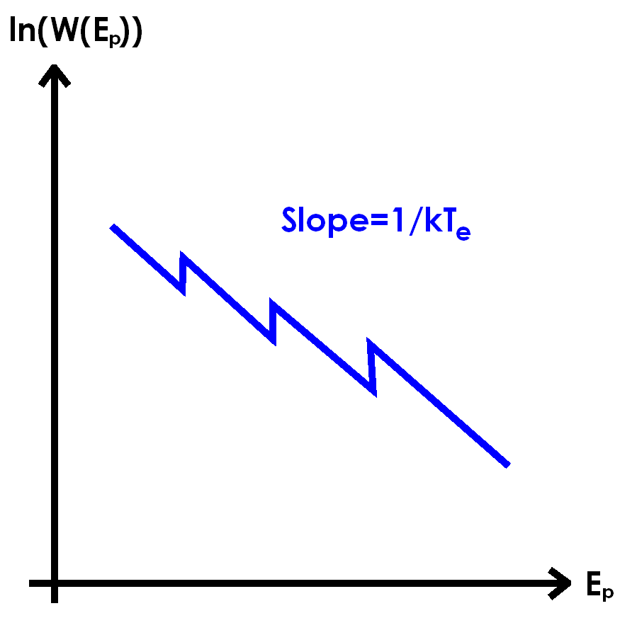
Recombination radiation: frequency spectrum
The overall frequency spectrum for recombinative radiation is similar to Bremsstrahlung apart from an additional term representing subsequent ionization stages.
If the measured frequency range covers multiple ionization levels then the ‘slope’ can still be used to determine the electron temperature.

Slide 17
Active optical diagnostic techniques

